Slide 1


<Name>
<Date>

Slide 2

Outline
Executive Summary
Introduction
Methodology
Results
Conclusion
Appendix

Slide 3
Executive Summary
Summary of methodologies
Summary of all results

Slide 4
Introduction
Project background and context
Problems you want to find answers

Slide 5


Slide 6
Methodology
Executive Summary
Data collection methodology:
Describe how data was collected
Perform data wrangling
Describe how data was processed
Perform exploratory data analysis (EDA) using visualization and SQL
Perform interactive visual analytics using Folium and Plotly Dash
Perform predictive analysis using classification models
How to build, tune, evaluate classification models

Slide 7
Data Collection
Describe how data sets were collected.
You need to present your data collection process use key phrases and flowcharts

Slide 8
Data Collection – SpaceX API
Present your data collection with SpaceX REST calls using key phrases and flowcharts
Completed SpaceX API calls notebook - GitHub
Place your flowchart of SpaceX API calls here

Slide 9
Data Collection - Scraping
Present your web scraping process using key phrases and flowcharts
Completed data collection with web scraping notebook - GitHubaping notebook
Place your flowchart of web scraping here

Slide 10
Data Wrangling
Describe how data were processed
You need to present your data wrangling process using key phrases and flowcharts
Completed data wrangling notebook - GitHub

Slide 11
EDA with Data Visualization
Summarize what charts were plotted and why you used those charts
Completed EDA with data visualization notebook - GitHub

Slide 12
EDA with SQL
Using bullet point format, summarize the SQL queries you performed
Completed EDA with SQL notebook - GitHub

Slide 13
Build an Interactive Map with Folium
Summarize what map objects such as markers, circles, lines, etc. you created and added to a folium map
Explain why you added those objects
Completed interactive Folium map - GitHub

Slide 14
Build a Dashboard with Plotly Dash
Summarize what plots/graphs and interactions you have added to a dashboard
Explain why you added those plots and interactions
Add the GitHub URL of your completed Plotly Dash lab, as an external reference and peer-review purpose

Slide 15
Predictive Analysis (Classification)
Summarize how you built, evaluated, improved, and found the best performing classification model
You need present your model development process using key phrases and flowchart
Completed predictive analysis lab - GitHub

Slide 16
Results
Exploratory data analysis results
Interactive analytics demo in screenshots
Predictive analysis results

Slide 17


Slide 18
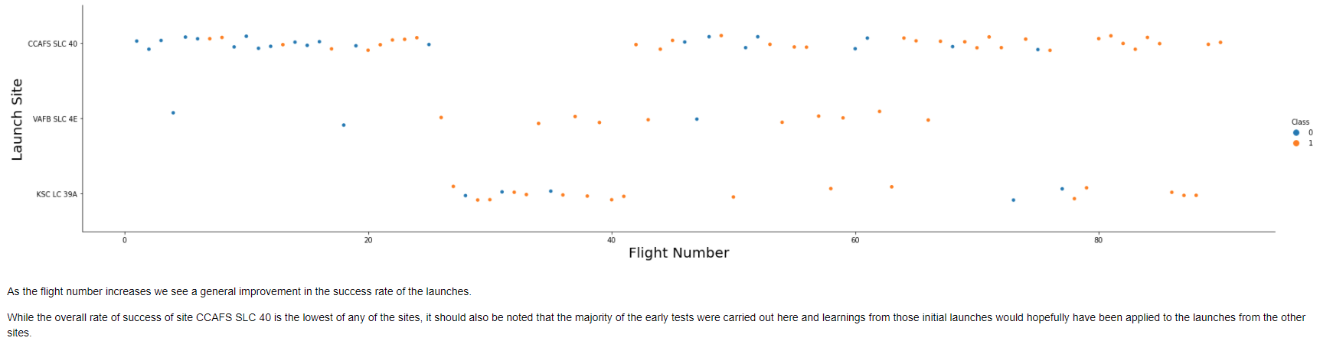
Flight Number vs. Launch Site

Slide 19
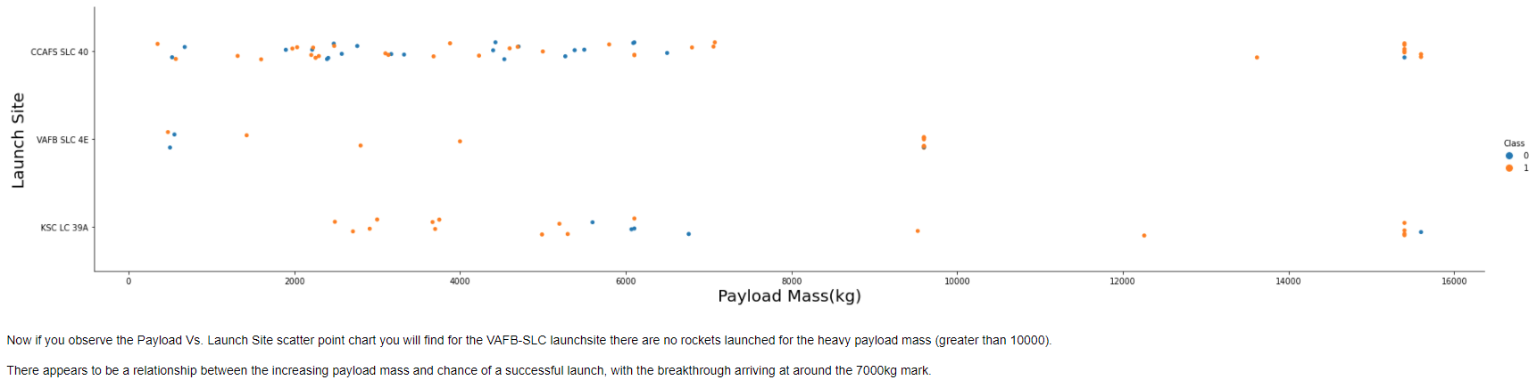
Payload vs. Launch Site

Slide 20
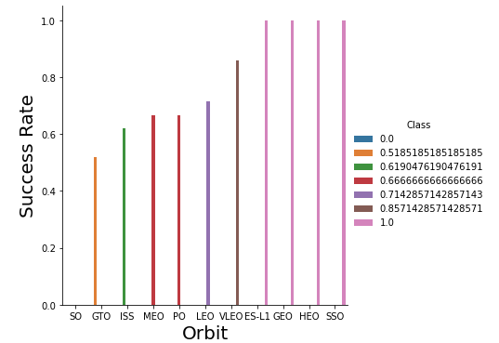
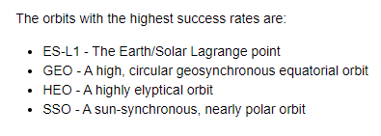
Success Rate vs. Orbit Type

Slide 21
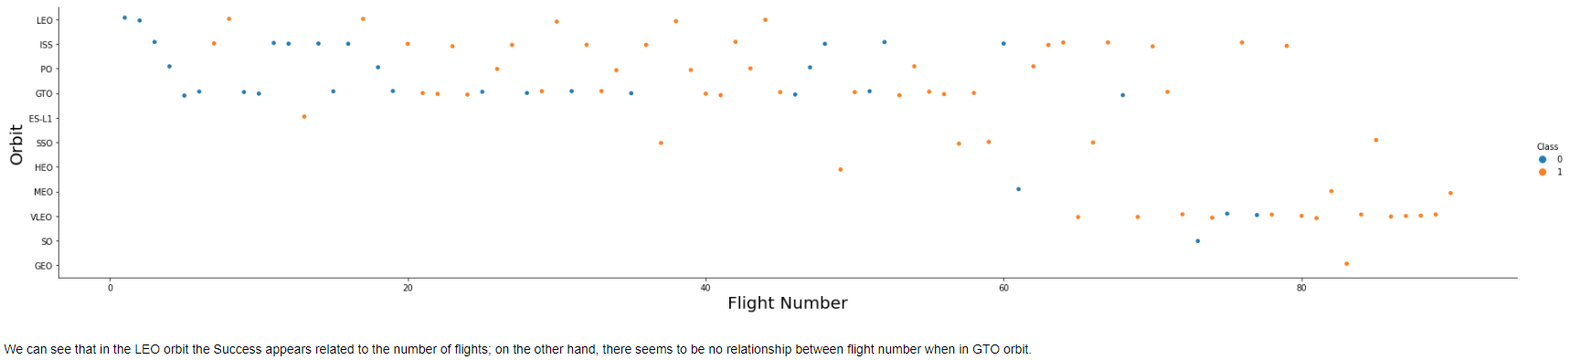
Flight Number vs. Orbit Type

Slide 22
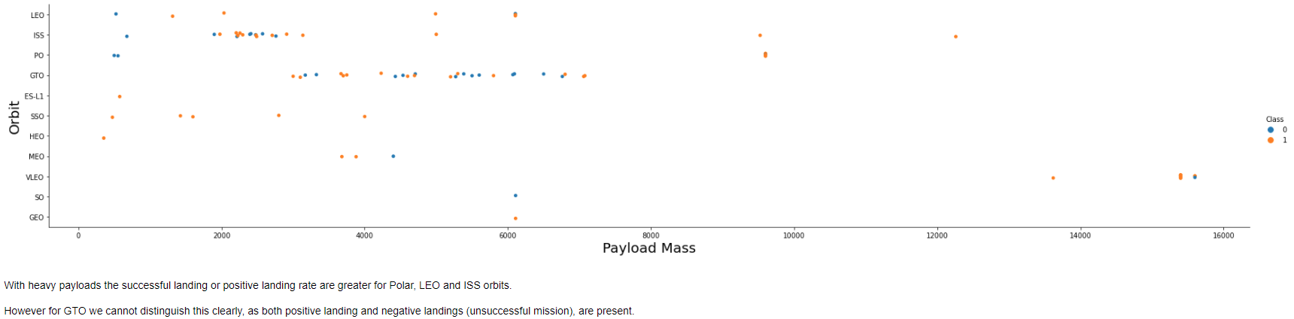
Payload vs. Orbit Type

Slide 23
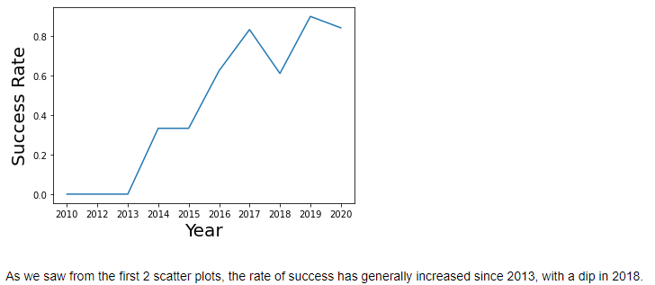
Launch Success Yearly Trend

Slide 24
All Launch Site Names
There are 4 unique launch sites:
CCAFS LC-40, CCAFS SLC-40, KSC LC-39A and VAFB SLC-4E
These were identified from the SpaceX DataSet using the following query: select distinct(launch_site) from SPACEXTBL
This query is using the distinct statement to return a list of unique values from the launch_site column of the SPACEXTBL table which contains the SpaceX DataSet data

Slide 25
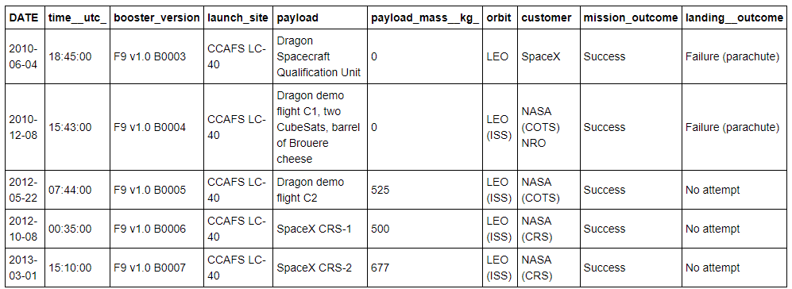
Launch Site Names Begin with 'CCA'
5 records where launch sites begin with `CCA`
select * from SPACEXTBL - select all records from the SpaceX DataSet where launch_site like 'CCA%’ - use the % wildcard after CCA to allow for different values LIMIT 5 - return only the first 5 results to meet the criteria

Slide 26
Total Payload Mass
The total payload carried by NASA (CRS) boosters was 45,596 kg
These were identified from the SpaceX DataSet using the following query: select sum(payload_mass__kg_) from SPACEXTBL where customer = 'NASA (CRS)'
This query is using the sum function to sum all values in the payload_mass_kg_ column of the SPACEXTBL table which was filtered on the customer with the name of NASA (CRS)

Slide 27
Average Payload Mass by F9 v1.1
The average payload mass carried by booster version F9 v1.1 was 2,928 kg
This was identified from the SpaceX DataSet using the following query:
select avg(payload_mass__kg_) from SPACEXTBL where booster_version LIKE 'F9 v1.1'
This query uses the avg function to find the mean of all payload mass values which were filtered by the booster version matching F9 v1.1

Slide 28
First Successful Ground Landing Date
The first successful landing outcome on ground pad was December 22nd 2015
This was identified from the SpaceX DataSet using the following query:
select min(date) from SPACEXTBL where landing__outcome like 'Success (ground pad)'
This query uses the min function to select the first (smallest) date which was filtered by the landing outcome of 'Success (ground pad)'

Slide 29
Successful Drone Ship Landing with Payload between 4,000 and 6,000 kg
The following boosters have successfully landed on the drone ship and had a payload mass greater than 4,000 kg but less than 6,000 kg:
F9 FT B1022, F9 FT B1026, F9 FT B1021.2 and F9 FT B1031.2
These were identified from the SpaceX DataSet using the following query:
select distinct(booster_version) from SPACEXTBL where payload_mass__kg_ between 4000 and payload_mass__kg_ < 6000 and landing__outcome like '%Success (drone ship)%'
This query uses the between keyword to select the payload mass range for the distinct 'Success (drone ship)' landing outcomes

Slide 30
Total Number of Successful and Failure Mission Outcomes
There was 1 failed mission outcome, 99 successful mission outcome, with 1 mission successful, but with an unclear payload status
This was identified from the SpaceX DataSet using the following query:
select count(mission_outcome),mission_outcome
from SPACEXTBL
group by mission_outcome
This query uses the count aggregation method and has been grouped by the mission outcome with the outcome included to aid display

Slide 31
Boosters Carried Maximum Payload
The following boosters have carried the maximum payload mass:
F9 B5 B1048.4, F9 B5 B1048.5, F9 B5 B1049.4, F9 B5 B1049.5, F9 B5 B1049.7, F9 B5 B1051.3, F9 B5 B1051.4, F9 B5 B1051.6, F9 B5 B1056.4, F9 B5 B1058.3, F9 B5 B1060.2, F9 B5 B1060.3
This was identified from the SpaceX DataSet using the following query:
select distinct(booster_version)
from SPACEXTBL
where payload_mass__kg_ =
(select max(payload_mass__kg_) from SPACEXTBL)
order by booster_version
This query uses a subquery to determine the maximum value of the payload mass, then uses that value to determine which boosters carried that mass

Slide 32
2015 Launch Records
The following are the failed landing_outcomes in drone ship, their booster versions, and launch site names for in year 2015:
These were identified from the SpaceX DataSet using the following query:
select date, landing__outcome, booster_version, launch_site
from SPACEXTBL
where year(date) = 2015
and landing__outcome like 'Failure (drone ship)'
This query uses the year function with the date field to return only those results from 2015
DATE | landing__outcome | booster_version | launch_site
2015-01-10 | Failure (drone ship) | F9 v1.1 B1012 | CCAFS LC-40
2015-04-14 | Failure (drone ship) | F9 v1.1 B1015 | CCAFS LC-40

Slide 33
Rank Landing Outcomes Between 2010-06-04 and 2017-03-20
The table below shows the frequency of the landing outcomes between June the 4th 2010 and March the 20th 2017 in descending order:
This was identified from the SpaceX DataSet using the following query:
select landing__outcome as "Landing Outcome", count(landing__outcome) as "Count" from SPACEXTBL where date between '2010-06-04' and '2017-03-20' group by landing__outcome order by 2 desc
This query again makes use of the between keyword to specify the date range; the grouping is by the landing outcome; and we rank the frequency referring to the aggregate column by number in the result set (2).
Landing Outcome | Count
No attempt | 10
Failure (drone ship) | 5
Success (drone ship) | 5
Controlled (ocean) | 3
Success (ground pad) | 3
Failure (parachute) | 2
Uncontrolled (ocean) | 2
Precluded (drone ship) | 1

Slide 34


Slide 35
<Folium Map Screenshot 1>
Replace <Folium map screenshot 1> title with an appropriate title
Explore the generated folium map and make a proper screenshot to include all launch sites’ location markers on a global map
Explain the important elements and findings on the screenshot

Slide 36
<Folium Map Screenshot 2>
Replace <Folium map screenshot 2> title with an appropriate title
Explore the folium map and make a proper screenshot to show the color-labeled launch outcomes on the map
Explain the important elements and findings on the screenshot

Slide 37
<Folium Map Screenshot 3>
Replace <Folium map screenshot 3> title with an appropriate title
Explore the generated folium map and show the screenshot of a selected launch site to its proximities such as railway, highway, coastline, with distance calculated and displayed
Explain the important elements and findings on the screenshot

Slide 38


Slide 39
<Dashboard Screenshot 1>
Replace <Dashboard screenshot 1> title with an appropriate title
Show the screenshot of launch success count for all sites, in a piechart
Explain the important elements and findings on the screenshot

Slide 40
<Dashboard Screenshot 2>
Replace <Dashboard screenshot 2> title with an appropriate title
Show the screenshot of the piechart for the launch site with highest launch success ratio
Explain the important elements and findings on the screenshot

Slide 41
<Dashboard Screenshot 3>
Replace <Dashboard screenshot 3> title with an appropriate title
Show screenshots of Payload vs. Launch Outcome scatter plot for all sites, with different payload selected in the range slider
Explain the important elements and findings on the screenshot, such as which payload range or booster version have the largest success rate, etc.

Slide 42


Slide 43
Classification Accuracy
Visualize the built model accuracy for all built classification models, in a bar chart
Find which model has the highest classification accuracy

Slide 44
Confusion Matrix
Show the confusion matrix of the best performing model with an explanation

Slide 45
Conclusions
Point 1
Point 2
Point 3
Point 4
…

Slide 46
Appendix
Include any relevant assets like Python code snippets, SQL queries, charts, Notebook outputs, or data sets that you may have created during this project

Slide 47


